Slide 1
HK Light Bus Market Research
(9 May 2025)

Slide 2
Outline
Light Bus Market Overview
Key Dealer in HK
Price Comparison between EV and Diesel and Government Funding
Key Customer
Summary
Notes:
This growth was primarily driven by a rebound in government spending and significant growth in fixed capital formation.

Slide 3
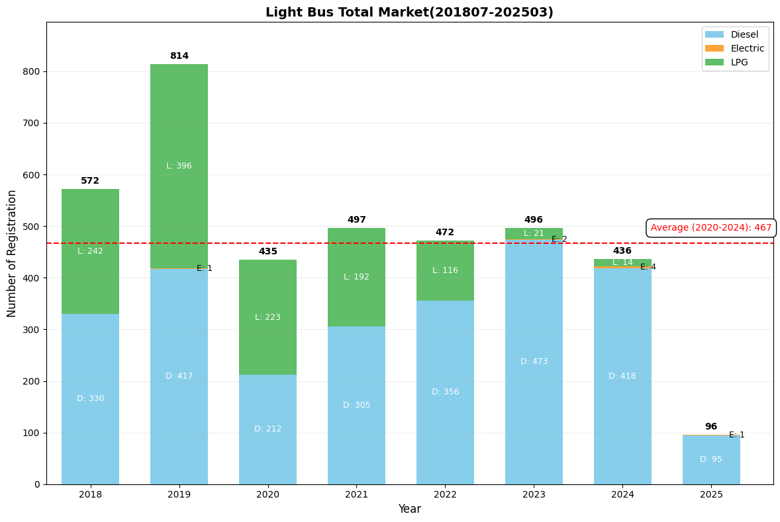
Total Market
Total Market Trend
Toyota Coaster stopped production of LPG by the end of 2020. Hong Kong will shift to supplying Euro VI diesel light bus. Consequently, LPG usage has been steadily declining since reaching its peak in 2019.
In 2020, registrations dropped from 814 to 435 vehicles which was primarily due to the COVID-19 pandemic.
In October 2020, a scraping program was launched to phase out Euro 4 diesel CV by the end of 2027. (Subsidy amount: HK$210K-250K)
Market Size and share Trend
By 2027, the overall market is projected to have approximately 450-500 vehicle registrations annually. The main buyers will be those replacing Euro IV vehicles.
Currently, the market leader is Toyota Coaster. After 2020, following Toyota's discontinuation of LPG vehicles, FUSO began capturing Toyota's market share through diesel vehicles (increasing from 11.49% to 21.56% between 2020-2024).
FUSO offers better active safety features, with a price difference of 13%.
Notes:
Average daily revenue: 5,573
Monthly revenue: 167,190

Slide 4
Key Dealer in HK
Brand | Dealer | 201807-202503 Registration Quantity | Company Link
Toyota | Crown Motors | 2145 | https://www.toyota.com.hk
Mitsubishi Fuso | 環宇汽車有限公司 | 235 | https://www.mitsubishi-fuso.com.hk/about-us/corporate-profile/universal-cars-ltd/
GMI | 本地品牌 | 24 | http://www.gmi-hk.com/zh-hant/
Golden Dragon | 億達動力科技有限公司 | 12 | https://www.vertecmotors.com/zh-Hant/
Isuzu | Dah Chong Hong | 5 | https://www.dch.com.hk
MAN | MAN Truck & Bus | 3 | https://www.mantruckandbus.com
Ford | Ford Hong Kong | 3 | https://www.ford.com.hk
Mercedes-Benz | 仁孚行有限公司 | 2 | Mercedes-Benz Hong Kong
Notes:
Toyota has 5 service centers in HK

Slide 5
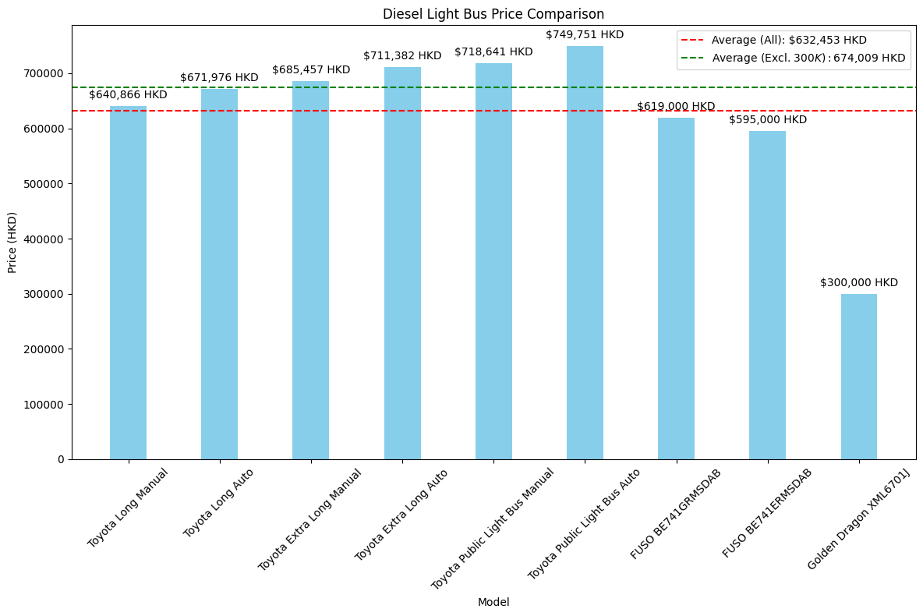
Diesel Light Bus Price Comparison
The light bus segment is dominated by Toyota, which commands premium pricing in the market.
FUSO presents a more cost-effective alternative with competitive pricing structures. Data indicates that the acceptable price threshold for Japanese brands in this segment is approximately HKD 680,000.
Despite Golden Dragon's position as the leading Chinese manufacturer in this segment and its highly competitive pricing strategy, this has not translated into proportional market share.

Slide 6
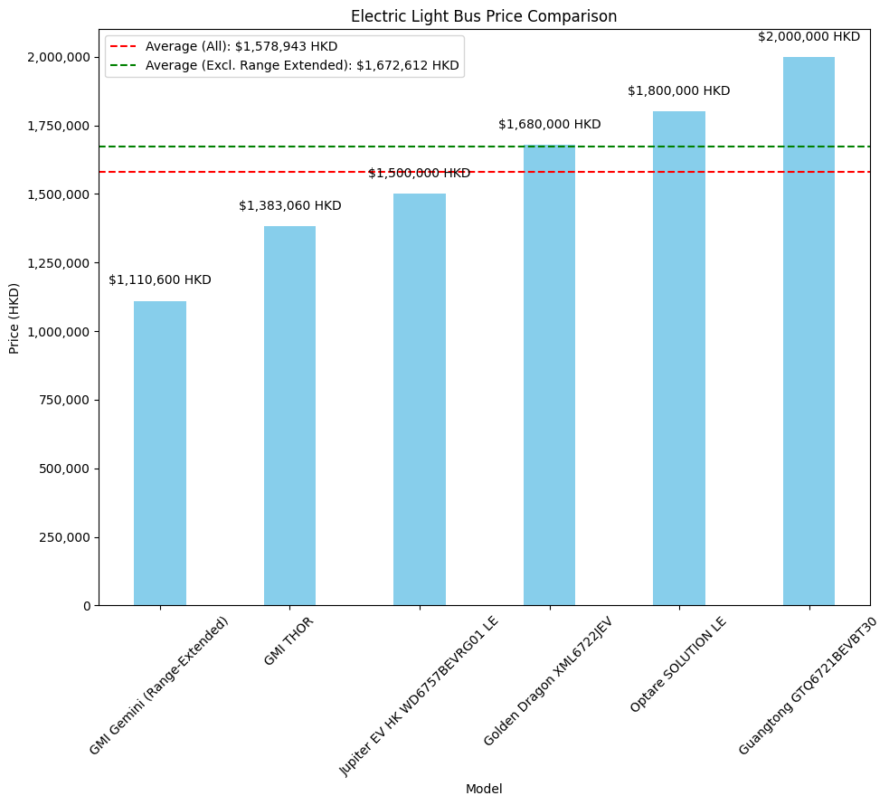
Electric Light Bus Price Comparison
In the electric light bus segment, GMI has been market leadership as the local Hong Kong manufacturer specializing in fully electric and range-extended vehicle solutions.
The current market pricing for fully electric bus models in this category is positioned at approximately HKD 1.68 million per unit.

Slide 7
EV Light Bus and Diesel Bus Price Comparison and Government Funding
Government Financial Incentives
The New Energy Transport Fund (NETF) ceased accepting applications as of April 1, 2025.
Pilot Scheme for Electric Public Light Buses is the current funding for EV light bus. The second phase of applications concluded on August 26, 2024, with five vehicle models receiving approval designation.
The forthcoming subsidy framework will provide capital expenditure support equivalent to 80% of the vehicle acquisition cost.
Market Price Analysis: Electric vs. Conventional Powertrains
GMI Thor is the market-leading model with a unit price of HKD 1.38 million, representing the market-validated price point for EV category.
Alternative models submitted for subsidy consideration may exceed optimal price thresholds for market acceptance.
Market analysis indicates the appropriate price positioning should range between HKD 1.3-1.5 million. However, when compared to conventional diesel alternatives (HKD 700,000), the electric variants maintain a significant price premium.
This substantial price differential is directly reflected in market penetration metrics, with electric variants accounting for 0.21% of total market share during the period from July 2018 through March 2025.

Slide 8
Key Customer
Decentralized Operating Model
The main organizations segment purchasing light bus
Light Buses operations are managed by small companies or operating groups.
Unlike franchised bus companies, the light bus market is highly fragmented with no single dominant company.
Public light bus : Primary buyers with large fleets meeting public transportation needs.
Schools and educational institutions : For school bus services.
Private estate management companies: Providing shuttle services for residents.
Businesses and commercial : Employee transportation.
Tourism companies and hotels: For tourism and airport transfers.
Government and public: Testing new energy vehicles.
Non-governmental organizations: Serving vulnerable groups.
Individual investors: Independent operation of red light buses.
Main Operators
Public Light Bus
Koon Wing: 650 units
AMS Public Transport: 350units
Private Light Bus (Mainly be same as our VB customers)
Kong Bus
Jackson
New Power Transportation
Chun Wo Bus Service Ltd

Slide 9
Summary
Based on the government's previous experimental report, it would take approximately 3.7 years to recover the HK$1,000,000 price difference when replacing diesel vehicles with electric vehicles.
Unlike Volvo Buses, which has cross-border fleets that can afford higher prices, light bus operators are more price-sensitive due to revenue considerations.
Looking at brand market share, FUSO is showing an upward trend by leveraging better active safety features and lower prices.
Electric light bus are still in the early stages of adoption. Despite some deliveries due to government subsidies, current data shows the market remains very small. Considering the costs involved, future growth potential is also limited.
In the private light bus sector, many of our current VB customers also provide these services which means we can leverage with our current customers.
Toyota has five service centers for customers, far exceeding the second-place FUSO. The accessibility of after-sales service should be a key focus for the light bus segment.

